Slide 1
Smart Buy
Buy everything you need in a smart way

Slide 2
Team member
Supervisor: Mr. Kiều Trọng Khánh
Đoàn Hồ Anh Triết
Đặng Hữu Hoàng
Trần Trung Dũng
Huỳnh Thanh Việt (Dropped out)

Slide 3
Outline
Scenario problem
Advantages and disadvantages of current scenario
Proposed solution
Demonstration
Advantages and disadvantages of current solution
Questions and answers

Slide 4
Scenario Problem
Everyday, People go to the market to buy food for their daily meals.
Together with the growing use of smart phone today, we should find a smarter way to do our daily jobs, such as shopping.
Their buying habits:
At familiar market.
At the nearest market.
At random market.

Slide 5
Advantages and Disadvantages of current habits
At familiar market:
Advantages: familiar with many things, trusted quality.
Disadvantages: can’t explore new things at new markets, not sure if the price is appropriate.
At the nearest market:
Advantages: save travelling time and effort.
Disadvantages: price can be high, quality cannot be trusted.
At random market:
Advantages: have the latest information of many markets.
Disadvantages: price can be high, quality cannot be trusted.

Slide 6






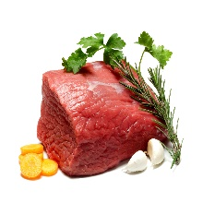









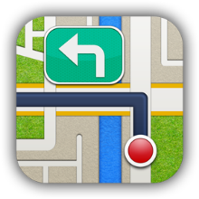

Smart Buy System
1.1
1.4
1.2
1.3
2.3
2.6
2.4
2.2
2.5
2.1

Slide 7


Slide 8

Demo Scenario - Guest
Search Product
Add to cart.
View cart

Slide 9

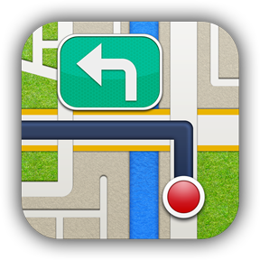
Demo Scenario - Member
Define Routes
Ask for suggestion

Slide 10




Demo Scenario - Staff
Import data
Train machine
Manage parsers

Slide 11
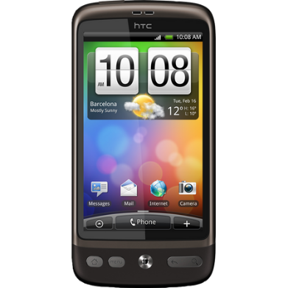

Latest Price
Give suggestion
Require device
Require internet connection

Slide 12
THANK YOU FOR YOUR ATTENTION! Q & A

